Slide 1
Object Oriented Programming with Java
Day 12

Slide 2
Understanding Swing Components
GUI components
Buttons, text fields, and other components with which the user can interact
Swing components:
Are descendants of JComponent
Inherit from the java.awt.Container class
To take advantage of the Swing GUI components and their methods, insert: import javax.swing.*; at the beginning of Java program files

Slide 3
Understanding Swing Components
Container
A type of component that holds other components
Allows a group to be treated as a single entity
Defined in the Container class
Often takes the form of a window that you can:
Drag
Resize
Minimize
Restore
Close

Slide 4
Understanding Swing Components
Window class
A child of Container
Does not have title bars or borders
Is rarely used
Instead, use the following subclasses:
Frame
JFrame

Slide 5
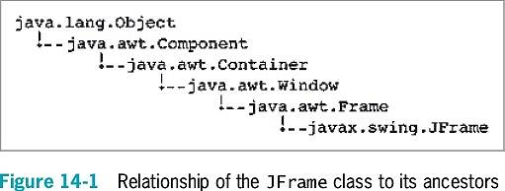
Using the JFrame Class

Slide 6
Using the JFrame Class
Create a JFrame so you can place other objects within it for display
The JFrame class has four constructors:
JFrame()
JFrame(String title)
JFrame(GraphicsConfiguration gc)
JFrame(String title, GraphicsConfiguration gc)

Slide 7
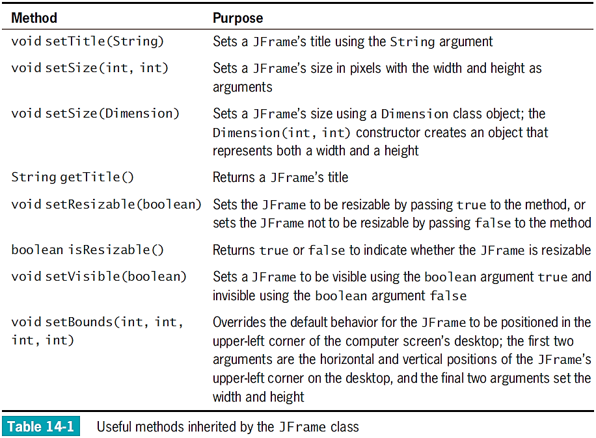

Slide 8
Using the JFrame Class
Create JFrame
JFrame firstFrame = new JFrame("Hello");
Set size and title
firstFrame.setSize(200, 100);
firstFrame.setTitle("My frame");

Slide 9
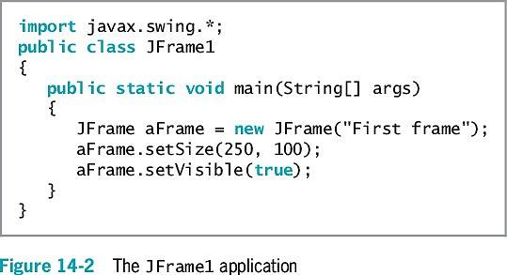
Using the JFrame Class
To close JFrame, click the Close button
Default behavior : JFrame becomes hidden and the application keeps running
To change this behavior, use the setDefaultCloseOperation() method

Slide 10
Customizing a JFrame’s Appearance
Window decorations
Icon and buttons
Look and feel
The default appearance and behavior of a user interface
The setDefaultLookAndFeelDecorated() method sets JFrame’s look and feel

Slide 11
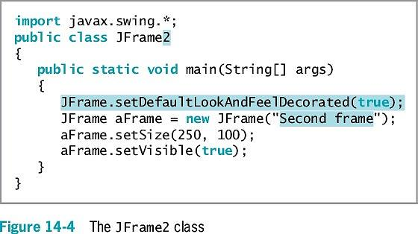
Customizing a JFrame’s Appearance

Slide 12
Using the JLabel Class
JLabel
Holds text you can display
Available constructors
Methods
add() method
remove() method
setText() method
getText() method
How is Java GUI labels different from HTML and JavaScript?
Why are they different?

Slide 13
Changing a JLabel’s Font
Font class
Creates an object that holds typeface and size information
To construct a Font object, you need three arguments:
Typeface
Style
Point size
setFont() method
A Font object argument is required

Slide 14
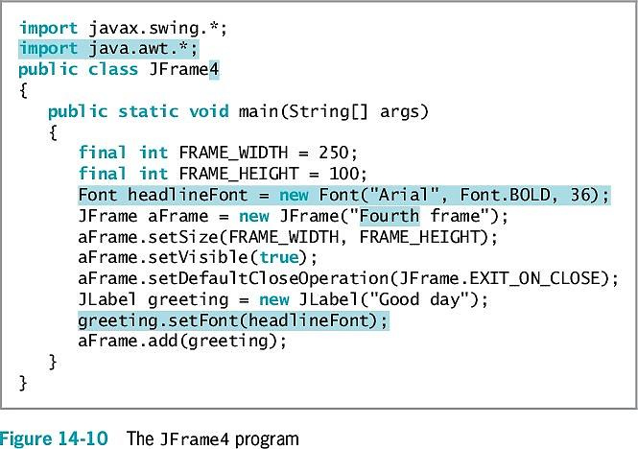
Changing a JLabel’s Font

Slide 15
Using a Layout Manager
Layout manager
A class that controls component positioning
BorderLayout
The normal (default) behavior of a JFrame
Divides a container into regions
Flow layout manager
Places components in a row
What is the equivalent of Java Layout Manager in HTML?

Slide 16
Extending the JFrame Class
When you create a class that descends from the JFrame class:
You can set the JFrame’s properties within your object’s constructor
Then, when the JFrame child object is created, it is automatically endowed with the features you specified
Create a child class using the keyword extends
Call the parent class’s constructor method using the keyword super

Slide 17
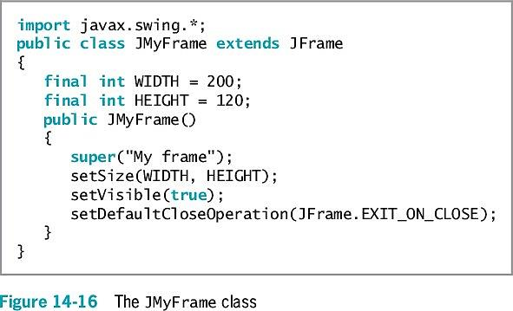
Extending the JFrame Class

Slide 18
Adding JTextFields, JButtons, and Tool Tips to a JFrame
In addition to including JLabel objects, JFrames often contain other window features, such as:
JTextFields
Jbuttons
Tool tips

Slide 19
Adding JTextFields
JTextField
A component into which a user can type a single line of text data
Has several constructors
Methods
setText() method
getText() method
setEditable() method

Slide 20
Adding JButtons
JButton
Click with a mouse to make a selection
Has five constructors
Methods include: setText()and getText()
add() method
Adds a JButton to a Jframe
When clicked, no resulting actions occur
The code has not yet been written to handle user-initiated events

Slide 21
Using Tool Tips
Tool tips
Are popup windows
Help a user understand the purpose of components in an application
Appear when a user hovers the mouse pointer over the component
setToolTipText() method
Set a tool tip for a Component

Slide 22
Learning About Event-Driven Programming
Event
Occurs when a user takes action on a component, such as clicking the mouse on a JButton object
Event-driven program
A program in which the user might initiate any number of events in any order
Source
The component on which an event is generated
Listener
The object that is interested in an event
To respond to user events within any class you create, you must:
Prepare your class to accept event messages
Tell your class to expect events to happen
Tell your class how to respond to events

Slide 23
Preparing Your Class to Accept Event Messages
Import the java.awt.event package
Add the phrase implements ActionListener to the class header
Implementing ActionListener provides you with standard event method specifications that allow your listener to work with ActionEvents

Slide 24
Telling Your Class to Expect Events to Happen
addActionListener() method
aButton.addActionListener(this);
Causes any ActionEvent messages (button clicks) that come from aButton to be sent to “this current object”

Slide 25
Telling Your Class How to Respond to Events
The ActionListener interface contains the actionPerformed(ActionEvent e) method specification
The body of the method contains any statements that you want to execute when the action occurs
When more than one component is added and registered to a JFrame, it might be necessary to determine which component was used
Find the source of the event using getSource();

Slide 26
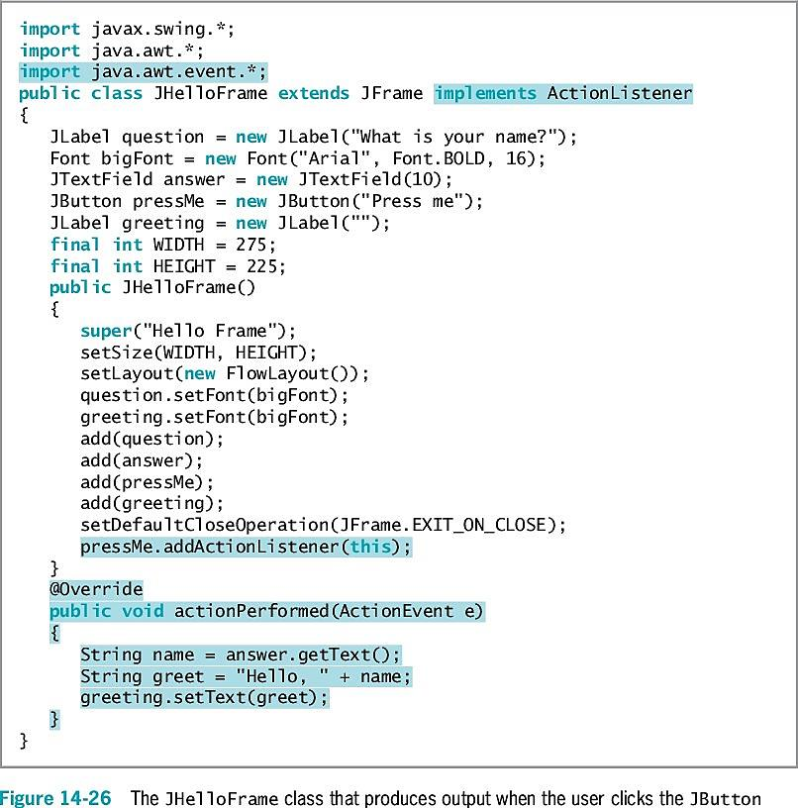
An Event-Driven Program
Figure 14-26 shows a JFrame that reacts to a button click
Import the event package
Within the actionPerformed()method, the String that a user has typed into the JTextField is retrieved and stored in the name variable and then used in the text of a second JLabel

Slide 27
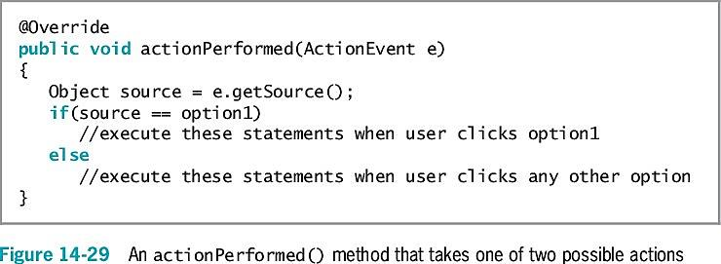
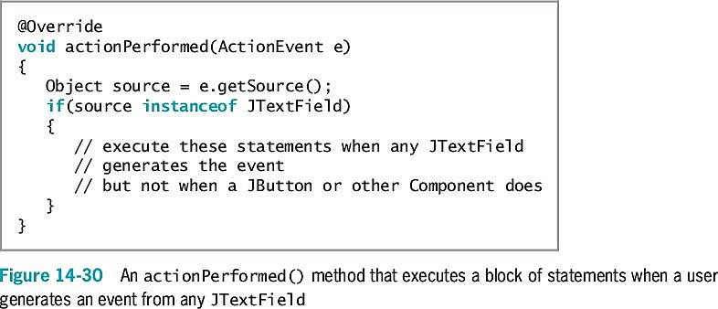
Using Multiple Event Sources
You can add more than one event source to a listener
Figure 14-29 shows a JFrame that reacts to either of two buttons
Alternatively, you can use instanceof to determine the event source (Figure 14-30)

Slide 28
Using the setEnabled() Method
setEnabled() method
Makes a component unavailable, and then makes it available again in turn
Use after a specific series of actions has taken place

Slide 29
Understanding Swing Event Listeners
Classes that respond to user-initiated events must implement an interface that deals with events called event listeners
Many types of listeners exist in Java
Each can handle a specific event type
A class can implement as many event listeners as it needs
An event occurs every time the user types a character or clicks the mouse button

Slide 30
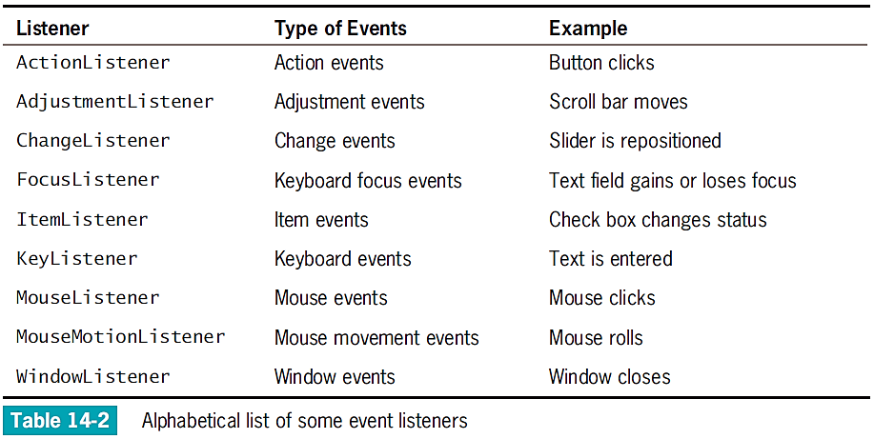
Understanding Swing Event Listeners

Slide 31
Understanding Swing Event Listeners
Create relationships between Swing components and classes that react to users’ manipulations of them
JCheckBox responds to the user’s clicks
addItemListener() method
Register JCheckBox as a type of object that can create an ItemEvent
Format
theSourceOfTheEvent.addListenerMethod (theClassThatShouldRespond);

Slide 32
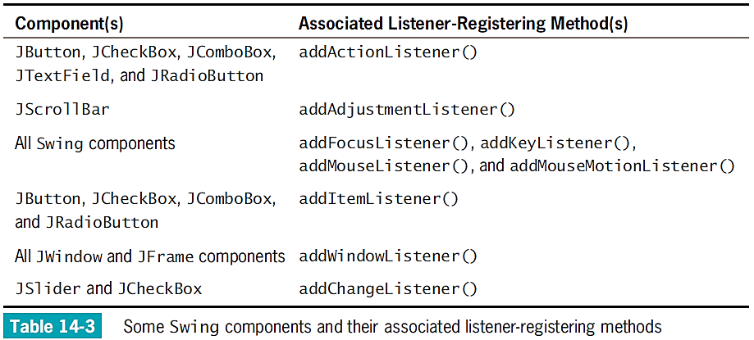
Understanding Swing Event Listeners

Slide 33
Understanding Swing Event Listeners
The class of the object that responds to an event contains a method that accepts the event object created by the user’s action
Specific methods react to specific event types
If you declare a class that handles an event, create a class to do one of the following:
Implement a listener interface
Extend a class that implements a listener interface

Slide 34
Understanding Swing Event Listeners
If you declare a class that extends MyFrame, you need not include implements ItemListener in its header
You must register each instance of the event-handling class as a listener for one or more components

Slide 35
Using the JCheckBox, ButtonGroup, and JComboBox Classes
Besides JButtons and JTextFields, several other Java components allow a user to make selections in a GUI environment

Slide 36
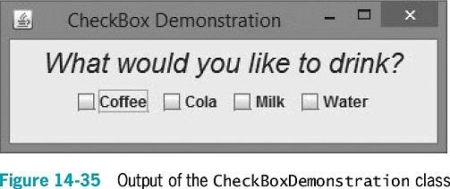
The JCheckBox Class
JCheckBox
Consists of a label positioned beside a square
Click the square to display or remove a check mark
Use to allow the user to turn an option on or off
Constructors
JCheckBox()
JCheckBox("Check here")
JCheckBox("Check here", false)

Slide 37
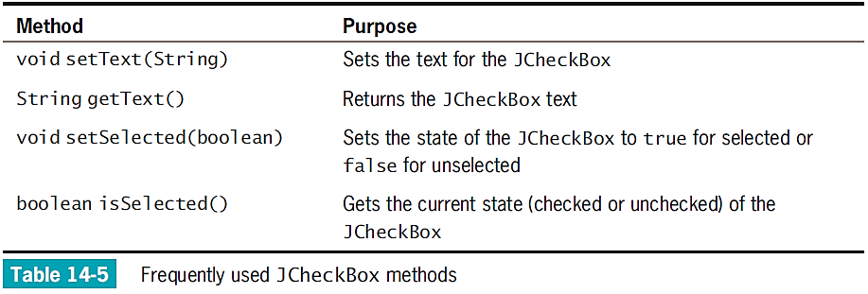
The JCheckBox Class
When the status of JCheckBox changes from unchecked to checked:
An ItemEvent is generated
The itemStateChanged() method executes

Slide 38
The ButtonGroup Class
ButtonGroup
Groups several components so that the user can select only one at a time
When you group JCheckBox objects, all of the other JCheckBoxes are automatically turned off when the user selects any one check box

Slide 39
The ButtonGroup Class
To create a ButtonGroup in a JFrame and then add JCheckBox:
Create a ButtonGroup
ButtonGroup aGroup = new ButtonGroup();
Create a JCheckBox
JCheckBox aBox = new JCheckBox();
Add aBox to aGroup
aGroup.add(aBox);

Slide 40
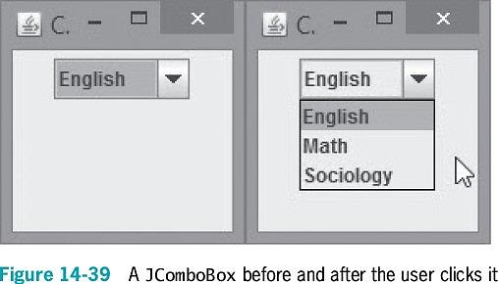
The JComboBox Class
JComboBox
A component that combines two features:
A display area showing a default option
A list box containing additional , alternate options
When the user clicks the JComboBox, a list of alternative items drops down
If the user selects one, it replaces the box’s displayed item

Slide 41
The JComboBox Class (cont’d.)
To build a JComboBox:
Use a constructor with no arguments and then add items with the addItem() method
Alternatively, use an array of Objects as the constructor argument
String[] majorArray = {"English", "Math", "Sociology"};
JComboBox majorChoice = new JComboBox(majorArray);

Slide 42
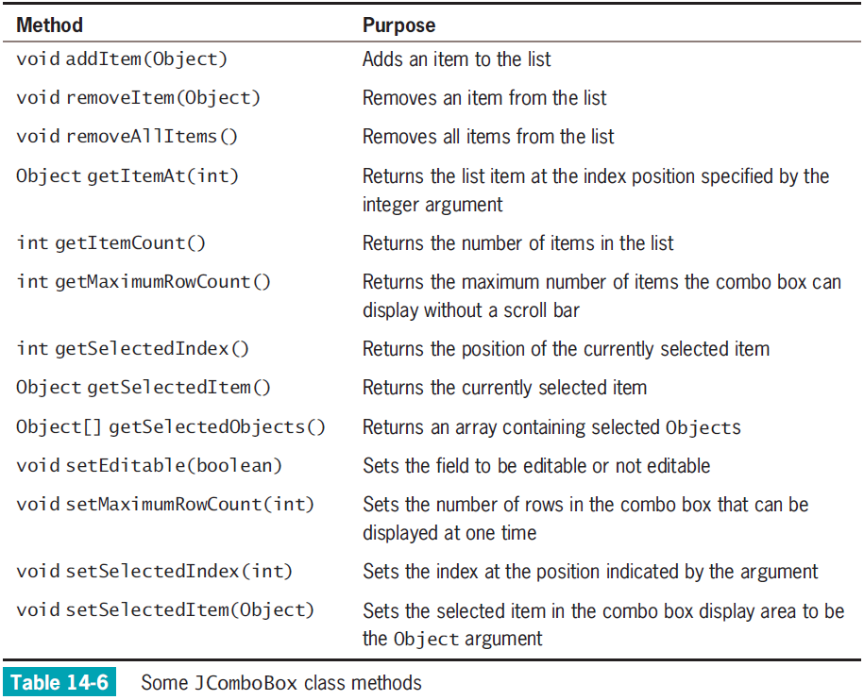

Slide 43
The JComboBox Class
setSelectedItem() or setSelectedIndex() method
Choose one item in the JComboBox to be the selected item
getSelectedItem() or getSelectedIndex() method
Discover which item is currently selected
Treat the list of items in a JComboBox object as an array
The first item is at position 0
The second item is at position 1
And so on

Slide 44
Don’t Do It
Don’t forget the x in javax when you import Swing components into an application
Don’t forget to use a JFrame’s setVisible()method if you want the JFrame to be visible
Don’t forget to use setLayout()when you add multiple components to a Jframe
Don’t forget to call validate()and repaint()after you add or remove a component from a container that has been made visible
Don’t forget that creating a ButtonGroup does not cause components to be grouped; each component that should be in the group must be added explicitly
Don’t forget that the ButtonGroup class does not begin with a J

Slide 45
Summary
JFrame
A Swing container that resembles a window
Has a title bar and borders, and the ability to be resized, minimized, restored, and closed
Many types of listeners exist in Java
Each can handle a specific event type
Register a listener with the event source
Handle an event in the event-handling method
JCheckBox
Consists of a label positioned beside a square
ButtonGroup
Groups several components so the user can select only one at a time
JComboBox
Displays an area showing an option combined with a list box containing additional options

Slide 46
Exercise
Design an application for a pizzeria. The user makes pizza order choices from list boxes, and the application displays the price. The user can choose a pizza size of small ($7), medium ($9), large ($11) or extra large ($14), and one of the number of toppings. There is no additional charge for cheese, but any other topping adds $1 to the base price. Offer at least five different topping choices.

Slide 47
Exercise
Enhance the pizzeria application by adding images of the pizzas and toppings.
You will need to research how to use the javax.imageio.ImageIO class.

